Slide 1



ScentSoul

Slide 2


Car Mate
AI 驱动二手车车价 查询预测系统
机器学习 | 时间序列 | 人工智能

Slide 3


Scent Soul
Your personal fragrance finder
Here are three ways to find your perfect match

Slide 5




$
$
$

Slide 6
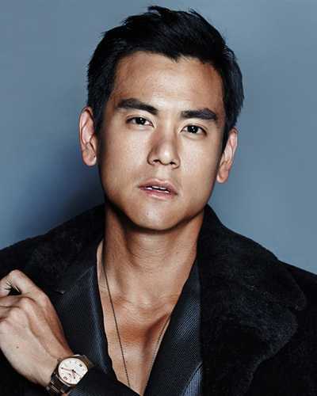


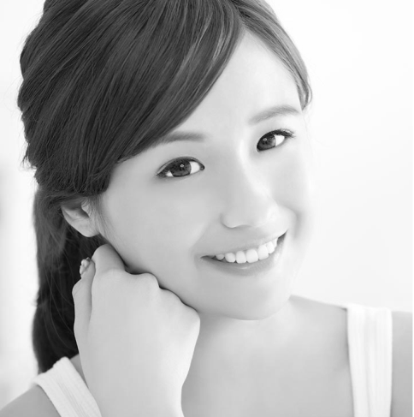

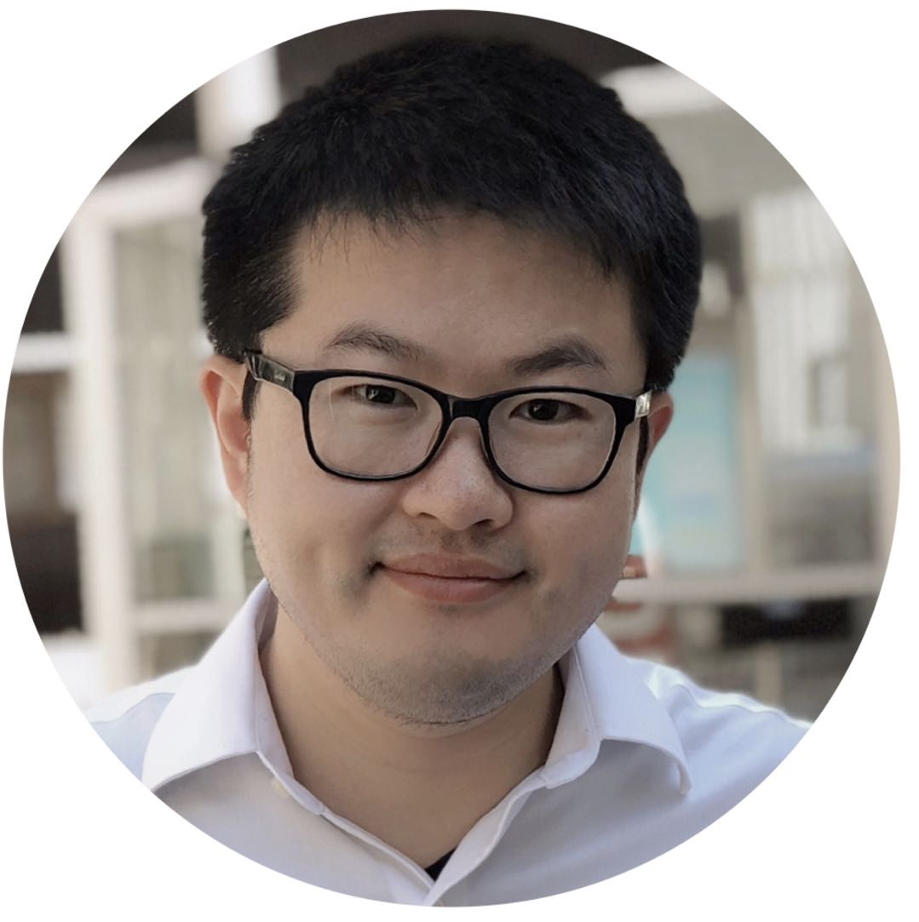
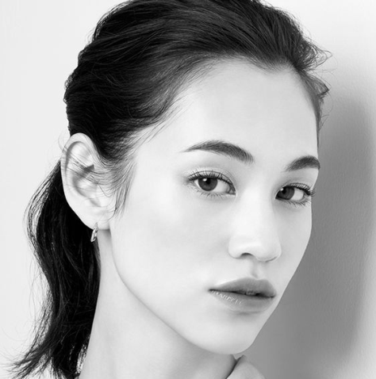

Slide 7

ScentSoul
Scent Soul
Your personal fragrance finder
Here are three ways to find your perfect match
- Since 2018
TAKE A QUIZ
FIND SIMILAR
SIGN IN

Slide 8


Tell me something about you…

Slide 9

CarMate
Scent Soul
CarMate
CarMate
CarMate

Slide 10






Slide 12


Slide 13


Slide 15
ScentSoul
Sign in About ScentSoul Contact me
ScentSoul
Your personal fragrance finder
Here are three ways to find your perfect match
TAKE A QUIZ
FIND SIMILAR
SIGN IN

Slide 16
https://www.thebathhouseshop.co.uk/woods-fragrance/
ScentSoul
Sig n in About ScentSoul Contact me
ScentSoul
您的香水管家
有三种方法带您寻找您的最爱
TAKE A QUIZ
FIND SIMILAR
SIGN IN

Slide 17
Scent Soul
Your personal fragrance finder
Here are three ways to find your perfect match

Slide 18

LOVE FROM ABOVE
Speaking from the heart with divine eloquence
such lovely fragrance love's inheritance

Slide 19
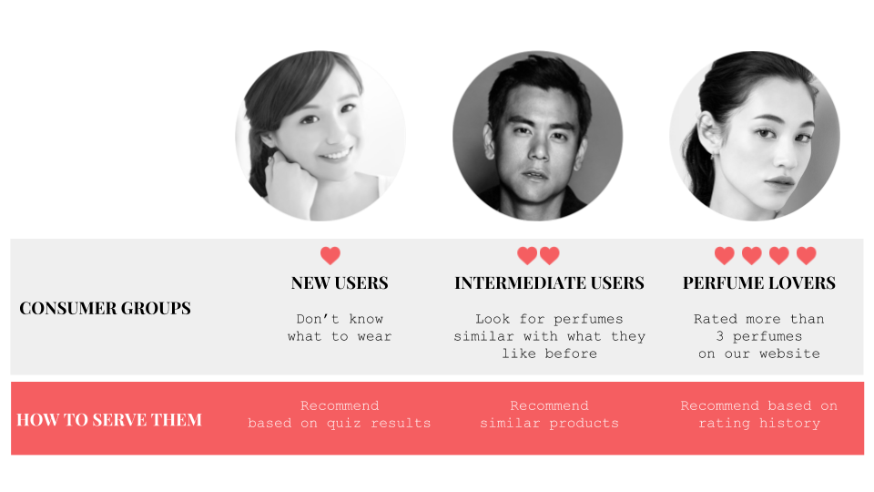

Slide 20


ScentSoul

Slide 21
ScentSoul
ScentSoul

Slide 22


Slide 23


Slide 24
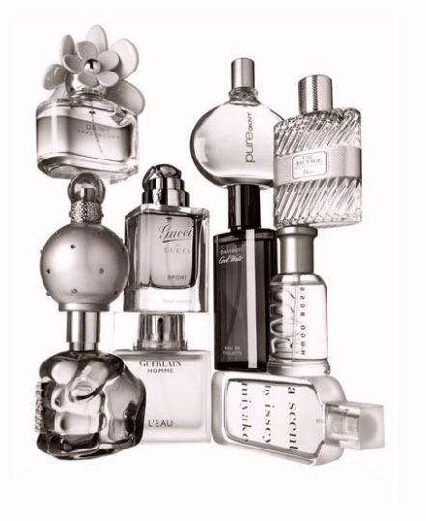



Slide 25

Scent Soul

Slide 27


Slide 28
https://www.thebathhouseshop.co.uk/citrus-fragrance/

Slide 30
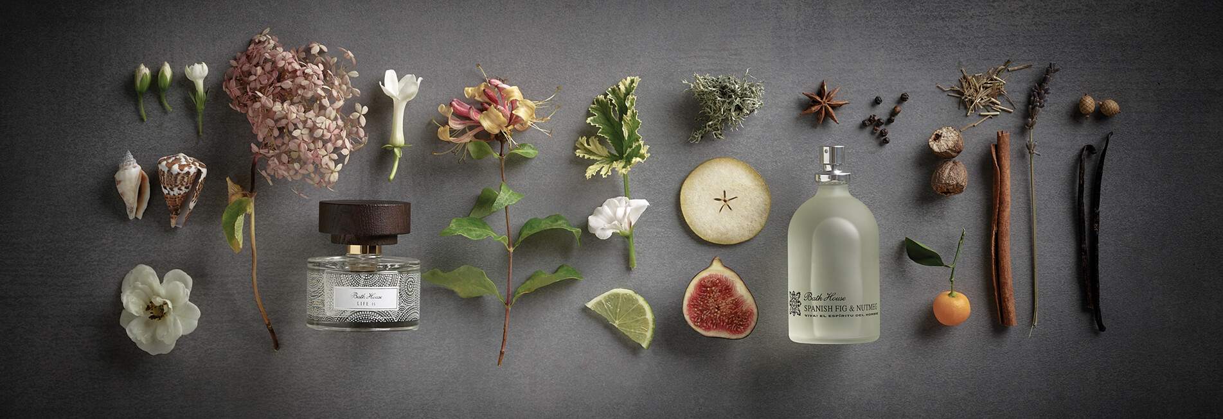

Slide 31
ScentSoul
Sing in About ScentSoul Contact me
ScentSoul
Your Personal fragrance finder
Ready to find the next fragrance?
Here are three ways to find your perfect match

Slide 32
ScentSoul
Sing in About ScentSoul Contact me
ScentSoul
Your Personal fragrance finder
Ready to find the next fragrance?
Here are three ways to find your perfect match

Slide 36


Slide 38
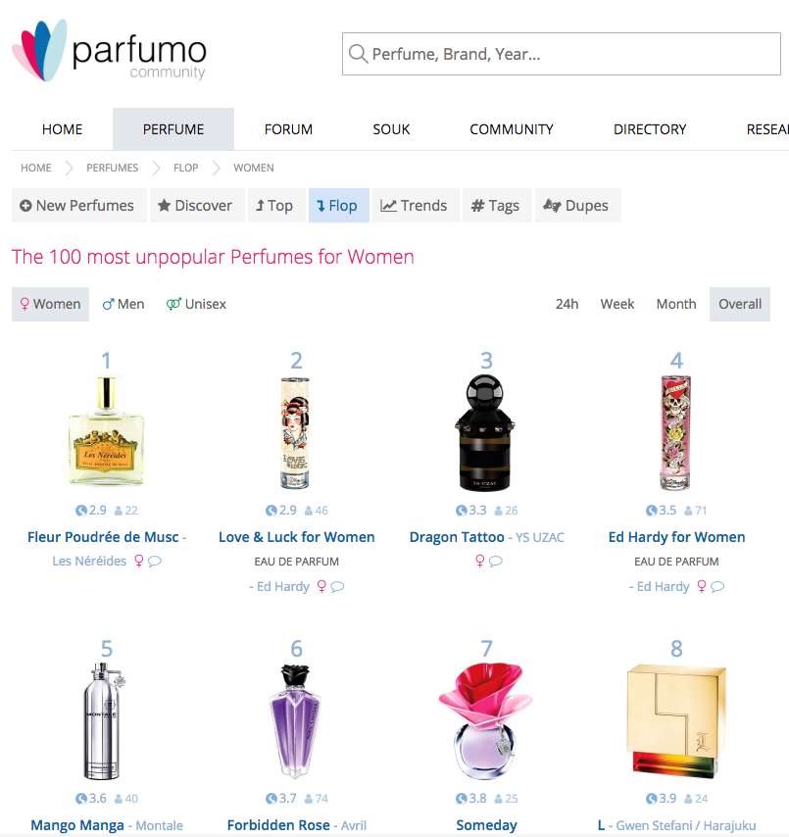
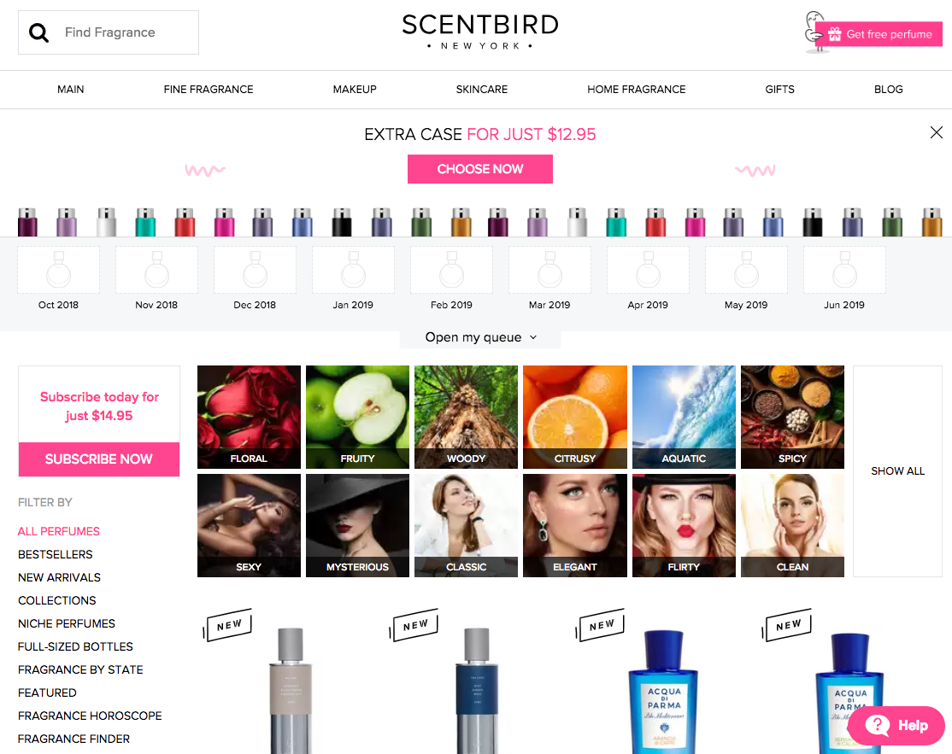
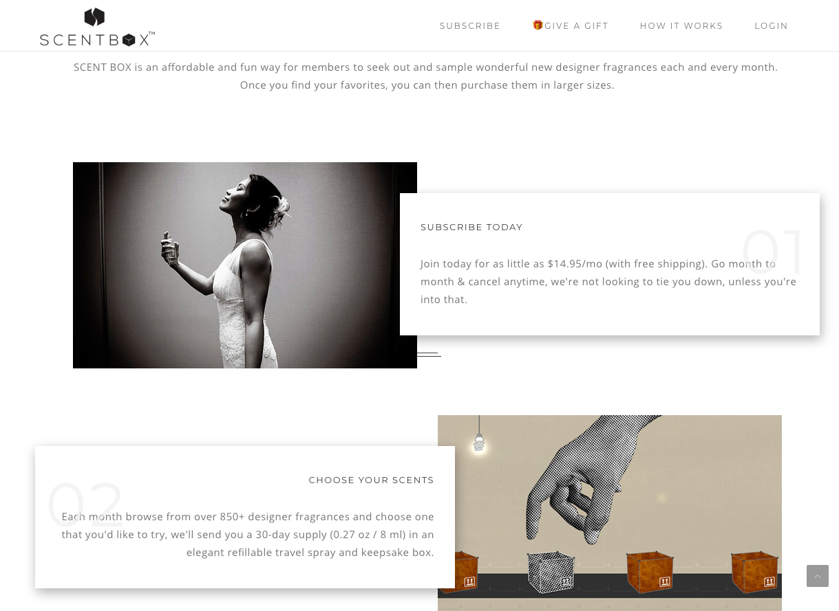
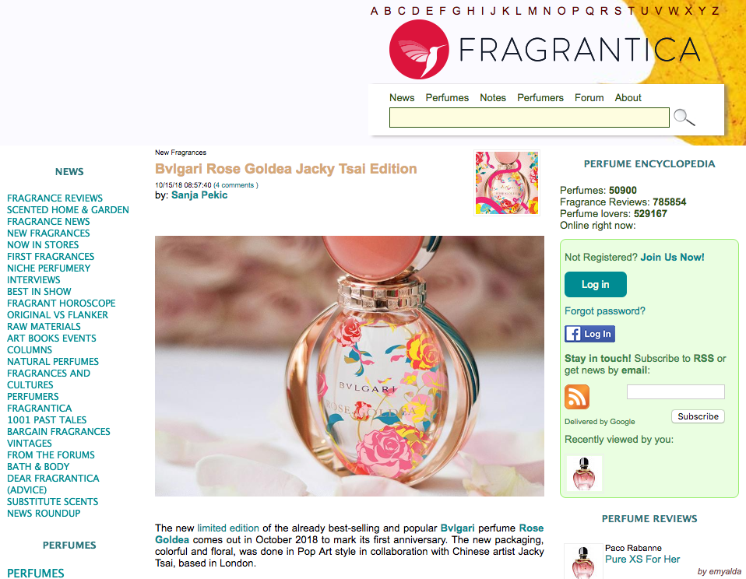

Slide 39
ScentSoul
EN
CN
Sing in About ScentSoul Contact me
ScentSoul
Your personal fragrance finder
Here are three ways to find your perfect match
TAKE A QUIZ
FIND SIMILAR
SIGN IN

Slide 40
ScentSoul
EN
CN
Sing in About ScentSoul Contact me
ScentSoul
Your personal fragrance finder
Here are three ways to find your perfect match
TAKE A QUIZ
FIND SIMILAR
SIGN IN

Slide 41
ScentSoul
EN
CN
Sing in About ScentSoul Contact me
Tell me something about you…

Slide 42


Slide 44
ScentSoul

